Slide 1
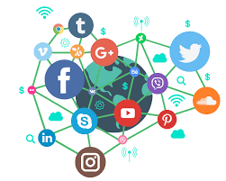
Importance of Social Media & Keeping the Public Informed
East Carroll Parish Communication District

